Slide 1
Third Year Electronic and Telecommunication
Digital Design
SEMINAR PRESENTATION
DIGITAL COMPARATOR WITH MULTIPLE INPUTS
Under the Guidance of : Prof. Abhya Chopde

Slide 2
Introduction
Problem Statement
Objective
Literature Survey
Methodology
Result And Discussion
Conclusion
Contents

Slide 3
INTRODUCTION
A digital comparator with multiple inputs is a fundamental building block in digital design that compares two or more digital values to determine their relationship to each other.
The increasing number and width of inputs can make designing an efficient and effective comparator circuit challenging.
To address this issue, we implemented a 4-bit digital comparator using Xilinx ISE and performed three different algorithms to compare four input values simultaneously and determine the largest input value.

Slide 4
PROBLEM STATEMENT :
Design and implement a 4-bit digital comparator with multiple inputs using Xilinx ISE
Evaluate three algorithms for finding the largest input value.
The existing algorithms for comparing multiple input numbers and determining the greatest value lack optimization and may exhibit redundancy, impacting computational efficiency.
There is a need to develop efficient algorithms that can handle a variable number of inputs and provide accurate comparison results while considering tie-breaking strategies and equal values.

Slide 5
OBJECTIVE
Optimize the computational efficiency of the algorithms to minimize processing time and improve overall performance.
Minimize redundancy in the algorithms by streamlining the code structure and eliminating unnecessary comparisons.
Enhance the scalability of the algorithms to handle a variable number of input numbers, allowing for flexibility in different application scenarios.
Ensure accurate comparison results by considering tie-breaking strategies and handling cases of equal values among the input numbers.

Slide 6
LITERATURE SURVEY

Slide 7
LITERATURE SURVEY :
Performance Evaluation of Digital Comparator Using Different Logic Circuits
[1]
Design and implement a digital comparator with including low power consumption, higher packing densities, and high-speed interface applications.
A modified transmission gate-based two-bit digital comparator, which utilizes only 30 transistors, significantly reducing the transistor count compared to existing transmission gate logic-based comparators. The design incorporates a half-adder logic circuit, resulting in reduced power consumption by 74.46%.
High-level Hardware Design of Digital Comparator With multiple inputs
[2]
The method utilizes a simple digital logic function to identify the largest or smallest value and its corresponding position among the inputs.
While the proposed method offers increased operating clock frequency by up to 3.45 times for 32 input signals, it comes at the cost of increased hardware resources. The implementation of the method using Verilog-HDL and testing with a 28 nm CMOS library resulted in hardware resource requirements up to 4.26 times higher than traditional methods.
Design of a Analog and digital comparator using FGMOS
[3]
Designs for both analog and digital comparators. The analog comparator utilizes the threshold voltage operation characteristic of floating-gate MOSFETs, allowing for hysteresis-tuning.
The analog comparator circuit is then converted into a digital comparator by replacing input devices with floating-gate MOSFETs, which generate linear sums of weighted multiple-input voltages.

Slide 8
LITERATURE SURVEY :
Optimization of digital comparator using the transmission gate logic style
[4]
A modified transmission gate logic-based 2-bit magnitude comparator is introduced and compared with other design techniques. The comparison is based on factors such as power consumption, delay, and transistor count
It consumes 35.77% less power compared to the existing transmission gate logic-based comparator, while maintaining similar power consumption to the pass transistor logic-based comparator.
2-Bit Magnitude Comparator Using Different logic styles
[5]
Design for a 2-bit magnitude comparator, which is used to compare the relative magnitudes of two 2-bit binary numbers. The comparator is designed using various logic styles, and the performance of these different styles is analyzed and compared.
The paper utilizes the Tanner EDA Tool to perform simulations of the designed 2-bit magnitude comparator. The simulations are conducted at 90nm technology
A Novel Design of 12-bit Digital Comparator Using multiplexer for high speed application in 32-nm CMOS Technology
[6]
Introduces a novel technique to improve the speed of a 12-bit comparator by utilizing three 4-bit comparator blocks instead of a single 12-bit comparator. By breaking down the comparison process into smaller blocks, they aimed to enhance the overall speed of the comparator.
The new technique achieved a 30% improvement in the speed of the 12-bit comparator compared to the traditional approach.

Slide 9
METHODOLOGY

Slide 10
Block Diagram :
4-Bit 4-I/P Digital Comparator
A[3:0]
A_gt
B[3:0]
B_gt
C[3:0]
C_gt
D[3:0]
D_gt

Slide 11
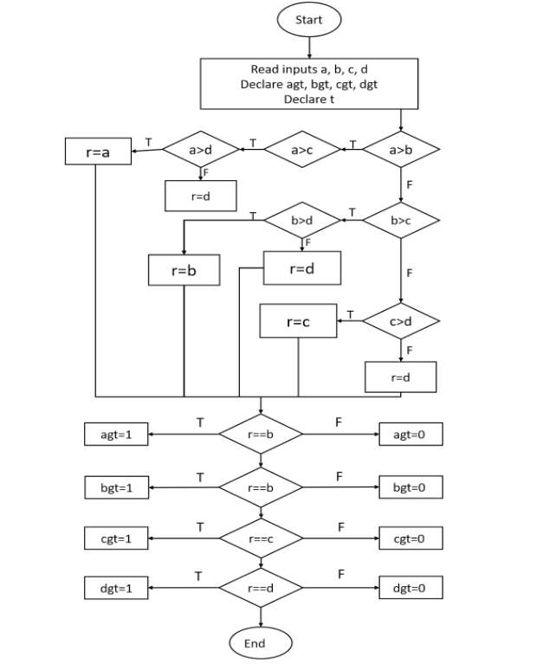
Functional Diagram : Algorithm 1

Slide 12
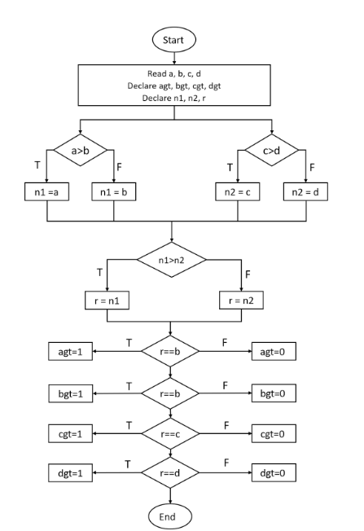
Functional Diagram : Algorithm 2

Slide 13
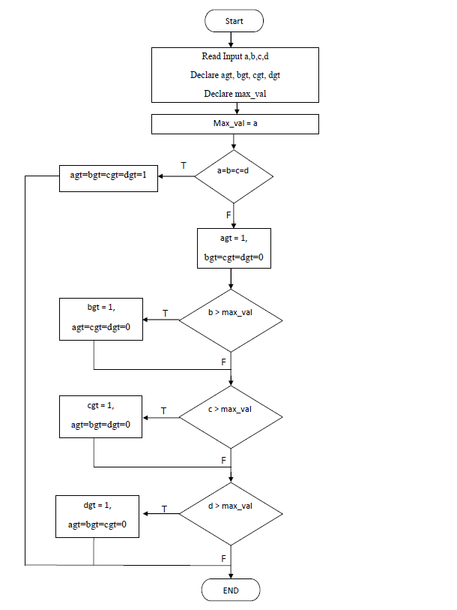
Functional Diagram : Algorithm 3

Slide 14
RESULT AND DISCUSSION

Slide 15
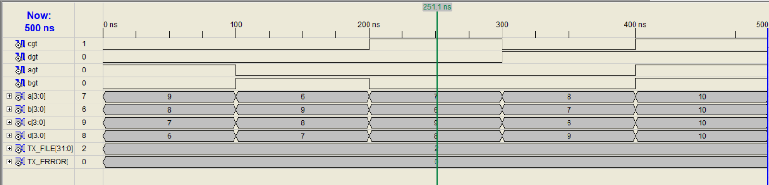
Test Bench Waveform :
Algorithm 1 :

Slide 16
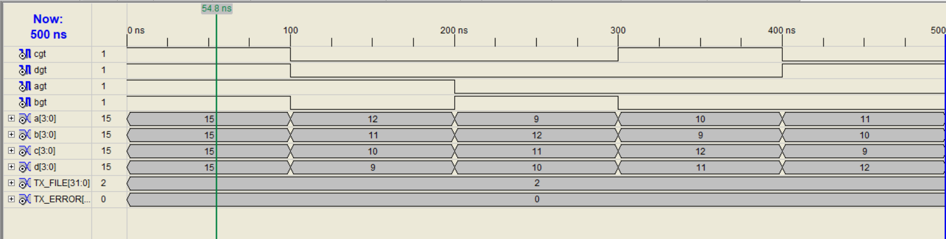
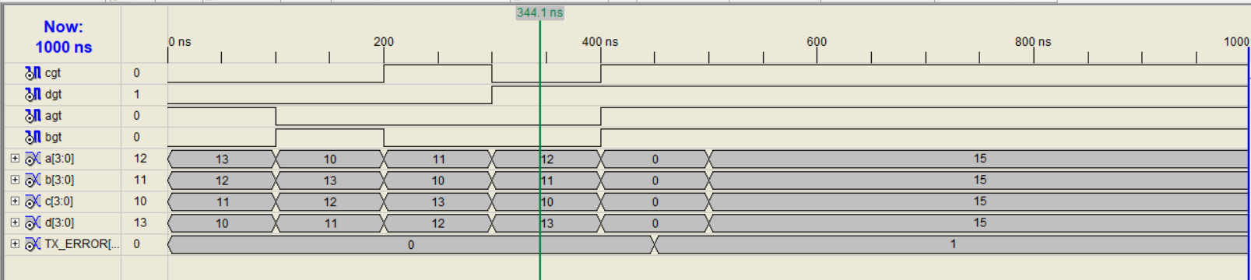
Test Bench Waveform :
Algorithm 2 :
Algorithm 3 :

Slide 17
Parameters
 | Algorithm 1 | Algorithm 2 | Algorithm 3
Comparator | 10 | 7 | 6
Latches | 4 | 0 | 0
Delay | 9.666ns | 22.098ns | 20.365ns
Total Power | 37.00 mW | 37.00mW | 37.00mW
Total memory usage | 157636 KB | 157316 KB | 157380 KB

Slide 18
CONCLUSION
We anticipate that by successfully completing
this project.
we will have a better understanding of the
design of digital comparators .
will have honed crucial abilities in the design,
simulation, and implementation of digital logic.

Slide 19
REFERENCE
[1] Mukherjee, D. N., Panda, S., & Maji, B. (2018). Performance evaluation of digital comparator
using different logic styles. IETE Journal of Research, 64(3), 422-429
[2] Mukherjee, D. N., Panda, S., & Maji, B. (2022). A novel design of 12-bit digital comparator
using multiplexer for high speed application in 32-nm cmos technology. IETE Journal of
Research, 68(2), 1350-1357.
[3] Seo, Y. H., Park, S. H., & Kim, D. W. (2019). High-level hardware design of digital comparator
with multiple inputs. Integration, 68, 157-165.
[4] Dibal, P. Y. Design of a 4-bit Magnitude Comparator using Simulink. Arid Zone Journal of
Engineering, Technology and Environment, 9.
[5] Mukherjee, D. N., Panda, S., & Maji, B. (2016). Optimization of digital comparator using
transmission gate logic style. Int. J. Adv. Res. Eng. Technol, 7(4), 06-16.
[6] Anjuli, S. A., & Satjajit, A. (2013). 2-bit magnitude comparator design using different logic
styles. International Journal of Engineering Science Invention, 2(1), 13-24.

